Slide 1

職場故事 (Animaze)
Notes:
Video by <a href="https://pixabay.com/users/mohamed_hassan-5229782/?utm_source=link-attribution&utm_medium=referral&utm_campaign=video&utm_content=62891">Mohamed Hassan</a> from <a href="https://pixabay.com//?utm_source=link-attribution&utm_medium=referral&utm_campaign=video&utm_content=62891">Pixabay</a>

Slide 2

Notes:
Video by <a href="https://pixabay.com/users/mohamed_hassan-5229782/?utm_source=link-attribution&utm_medium=referral&utm_campaign=video&utm_content=123689">Mohamed Hassan</a> from <a href="https://pixabay.com//?utm_source=link-attribution&utm_medium=referral&utm_campaign=video&utm_content=123689">Pixabay</a>

Slide 3

Notes:
Video by <a href="https://pixabay.com/users/blackmarketmusic-2976878/?utm_source=link-attribution&utm_medium=referral&utm_campaign=video&utm_content=136284">3 6</a> from <a href="https://pixabay.com//?utm_source=link-attribution&utm_medium=referral&utm_campaign=video&utm_content=136284">Pixabay</a>

Slide 4

1. 目標
Notes:
Video by <a href="https://pixabay.com/users/mohamed_hassan-5229782/?utm_source=link-attribution&utm_medium=referral&utm_campaign=video&utm_content=102869">Mohamed Hassan</a> from <a href="https://pixabay.com//?utm_source=link-attribution&utm_medium=referral&utm_campaign=video&utm_content=102869">Pixabay</a>

Slide 5

Notes:
Video by <a href="https://pixabay.com/users/athree23-6195572/?utm_source=link-attribution&utm_medium=referral&utm_campaign=video&utm_content=18438">Adrian</a> from <a href="https://pixabay.com//?utm_source=link-attribution&utm_medium=referral&utm_campaign=video&utm_content=18438">Pixabay</a>

Slide 6

Notes:
Video by <a href="https://pixabay.com/users/samidurrakzai-42221807/?utm_source=link-attribution&utm_medium=referral&utm_campaign=video&utm_content=202134">Sami Ullah</a> from <a href="https://pixabay.com//?utm_source=link-attribution&utm_medium=referral&utm_campaign=video&utm_content=202134">Pixabay</a>

Slide 7

2. 阻礙
Notes:
Video by <a href="https://pixabay.com/users/christianbodhi-9869182/?utm_source=link-attribution&utm_medium=referral&utm_campaign=video&utm_content=52430">Christian Bodhi</a> from <a href="https://pixabay.com//?utm_source=link-attribution&utm_medium=referral&utm_campaign=video&utm_content=52430">Pixabay</a>

Slide 8
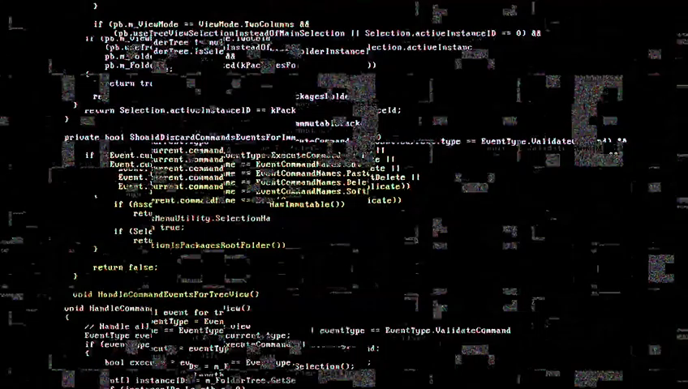
Notes:
Video by <a href="https://pixabay.com/users/ceos_stock-13890949/?utm_source=link-attribution&utm_medium=referral&utm_campaign=video&utm_content=27706">Nans Ceos</a> from <a href="https://pixabay.com//?utm_source=link-attribution&utm_medium=referral&utm_campaign=video&utm_content=27706">Pixabay</a>

Slide 9
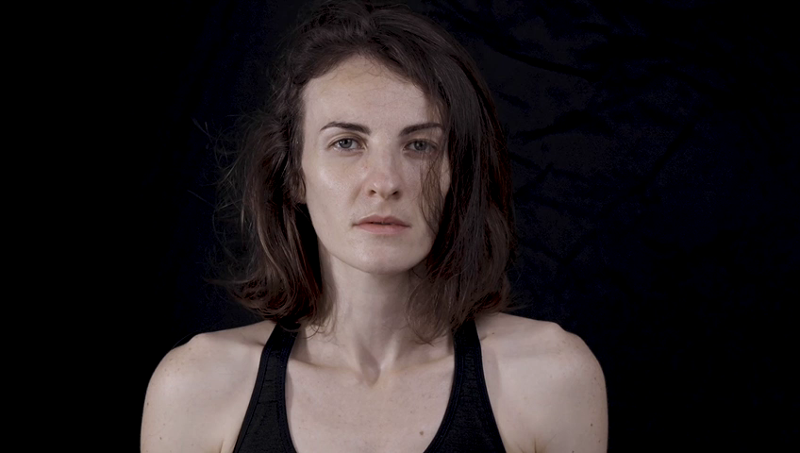
Notes:
Video by <a href="https://pixabay.com/users/engin_akyurt-3656355/?utm_source=link-attribution&utm_medium=referral&utm_campaign=video&utm_content=44646">Engin Akyurt</a> from <a href="https://pixabay.com//?utm_source=link-attribution&utm_medium=referral&utm_campaign=video&utm_content=44646">Pixabay</a>

Slide 10
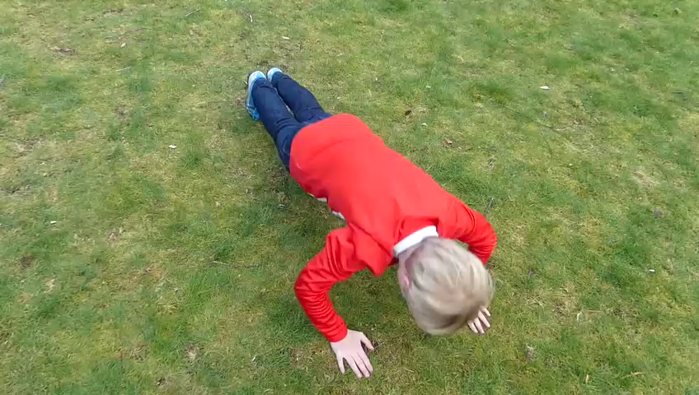
3. 努力
Notes:
Video by <a href="https://pixabay.com/users/ferdster-15554561/?utm_source=link-attribution&utm_medium=referral&utm_campaign=video&utm_content=38959">ferdster</a> from <a href="https://pixabay.com//?utm_source=link-attribution&utm_medium=referral&utm_campaign=video&utm_content=38959">Pixabay</a>

Slide 11
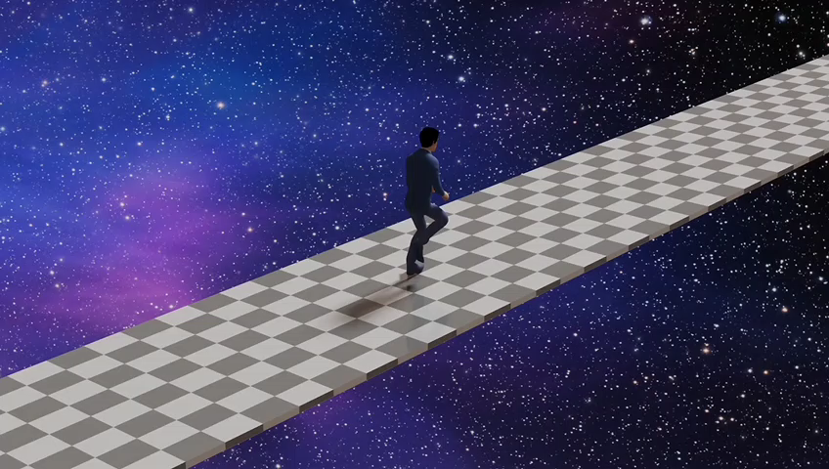
Notes:
Video by <a href="https://pixabay.com/users/christianbodhi-9869182/?utm_source=link-attribution&utm_medium=referral&utm_campaign=video&utm_content=107609">Christian Bodhi</a> from <a href="https://pixabay.com//?utm_source=link-attribution&utm_medium=referral&utm_campaign=video&utm_content=107609">Pixabay</a>

Slide 12
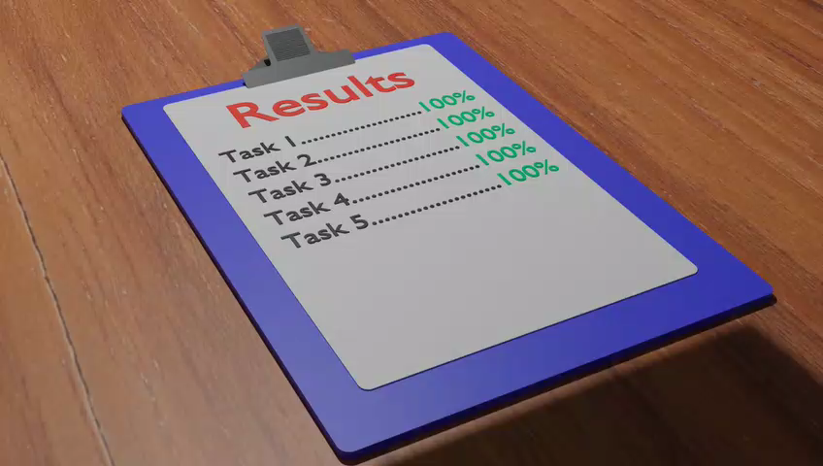
4. 結果
Notes:
Video by <a href="https://pixabay.com/users/grantmuller-4619676/?utm_source=link-attribution&utm_medium=referral&utm_campaign=video&utm_content=133176">Grant Muller</a> from <a href="https://pixabay.com//?utm_source=link-attribution&utm_medium=referral&utm_campaign=video&utm_content=133176">Pixabay</a>

Slide 13

Notes:
Video by <a href="https://pixabay.com/users/fe_da_silva-18482044/?utm_source=link-attribution&utm_medium=referral&utm_campaign=video&utm_content=168434">fe_da_silva</a> from <a href="https://pixabay.com//?utm_source=link-attribution&utm_medium=referral&utm_campaign=video&utm_content=168434">Pixabay</a>

Slide 14

5. 意外
Notes:
Video by <a href="https://pixabay.com/users/mastertux-470906/?utm_source=link-attribution&utm_medium=referral&utm_campaign=video&utm_content=148301">MasterTux</a> from <a href="https://pixabay.com//?utm_source=link-attribution&utm_medium=referral&utm_campaign=video&utm_content=148301">Pixabay</a>

Slide 15

Notes:
Video by <a href="https://pixabay.com/users/mohamed_hassan-5229782/?utm_source=link-attribution&utm_medium=referral&utm_campaign=video&utm_content=69588">Mohamed Hassan</a> from <a href="https://pixabay.com//?utm_source=link-attribution&utm_medium=referral&utm_campaign=video&utm_content=69588">Pixabay</a>

Slide 16
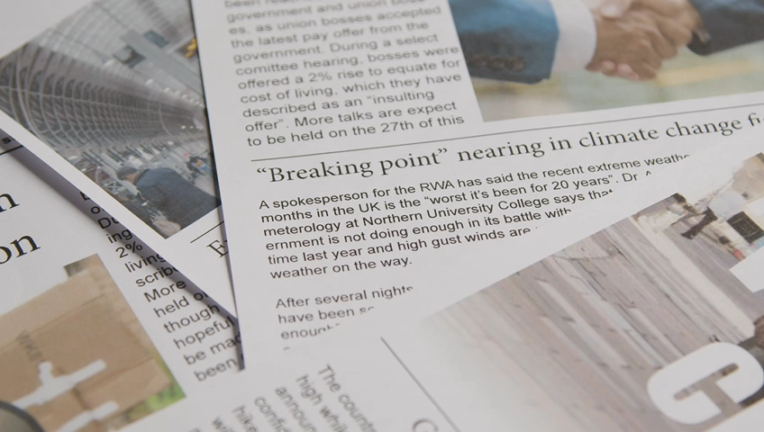
6. 轉彎
Notes:
https://www.videvo.net/video/newspaper-headline-discussing-strike-negotiations-in-trade-union-dispute-5/1799606/#rs=video-box

Slide 17

Notes:
Video by <a href="https://pixabay.com/users/life-of-vids-1282862/?utm_source=link-attribution&utm_medium=referral&utm_campaign=video&utm_content=3132">Life-Of-Vids</a> from <a href="https://pixabay.com//?utm_source=link-attribution&utm_medium=referral&utm_campaign=video&utm_content=3132">Pixabay</a>

Slide 18

Notes:
Video by <a href="https://pixabay.com/users/ninosouza-8385382/?utm_source=link-attribution&utm_medium=referral&utm_campaign=video&utm_content=23355">Nino Souza Nino</a> from <a href="https://pixabay.com//?utm_source=link-attribution&utm_medium=referral&utm_campaign=video&utm_content=23355">Pixabay</a>

Slide 19

7. 結局
Notes:
Video by <a href="https://pixabay.com/users/curious_collectibles-11004713/?utm_source=link-attribution&utm_medium=referral&utm_campaign=video&utm_content=33141">Shaun</a> from <a href="https://pixabay.com//?utm_source=link-attribution&utm_medium=referral&utm_campaign=video&utm_content=33141">Pixabay</a>

Slide 20

Notes:
Video by <a href="https://pixabay.com/users/asifjaved533-25101545/?utm_source=link-attribution&utm_medium=referral&utm_campaign=video&utm_content=135591">Asif Javed</a> from <a href="https://pixabay.com//?utm_source=link-attribution&utm_medium=referral&utm_campaign=video&utm_content=135591">Pixabay</a>

